Slide 1
Welcome to our Presentation

Slide 2
Submitted to
Mr. Ovishake Sen
Lecturer,
Dept. of Computer Science and Engineering,Southeast University

Slide 3
Group Members
Md.Abdullah Al Noman
ID: 2016000000152
Md.Samiul Islam
ID: 2017000000112
Md.Sojib Hoshen
ID:2017000000121

Slide 4
Introduction to Embedded System lab

Slide 5
SMOKE DETECTOR

Slide 6
Introduction
A smoke detector is a device that sense smoke, typically as an indicator of fire. Commercial security devices issue a signal to a fire alarm control panel as a part of a fire alarm system, while household smoke detectors, also known as smoke alarms, generally issue a local audible or visual alarm from the detector itself or several detectors if there are multiple smoke detectors interlinked.

Slide 7
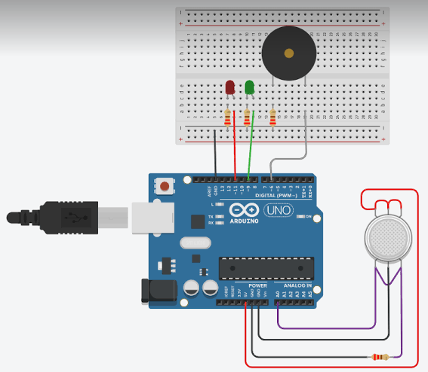
Block Diagram

Slide 8
COMPONENT REQUIRED
NODEMCU
Bread Board
MQ-2 SMOKE SENSOR
Wires

Slide 9
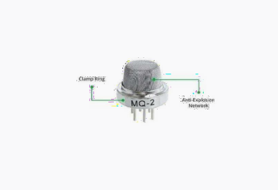
MQ-2 SMOKE SENSOR

Slide 10
MQ2 Gas sensor works on 5V DC and draws around 800mW.It can detect LPG, Smoke, Alcohol, Propane, Hydrogen,Methane and Carbon Monoxide de concentrations anywhere from 200 to can connect it to 5V output from your Arduino.
GND: is the Ground Pin and needs to be connected to GND pin on the Arduino.

Slide 11
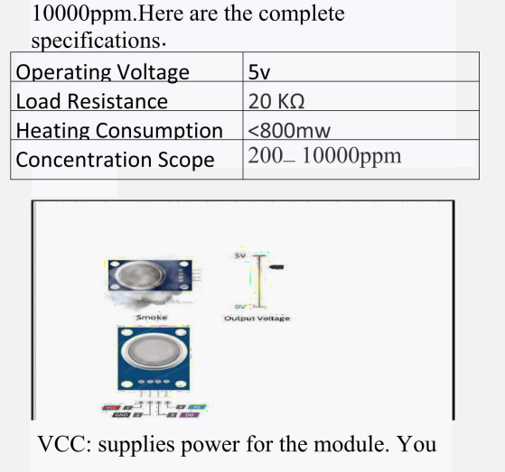

Slide 12
D0: provides a digital representation of the presence of combustible gases.
A0: provides analog output voltage in proportional to the concentration of smoke/gas.

Slide 13
How does it Work?
The voltage that the sensor outputs changes accordingly to the smoke/gas level that exists in the atmosphere.
The greater the gas concentration, the greater the output voltage
The lower the gas concentration, the lower the output voltage. The output can be an analog signal (A0) that can be read with an analog input of the Arduino or a digital output (D0) that can be read with a digital input of the Arduino.

Slide 14
Code
int smokeA0 = A0;
int buzzer =11;
float sensor value;
void setup()
{
pinMode(buzzer ,OUTPUT);
pinMode(smokeA0,INPUT);
Serial.begain(9600);
Serial.println(“gas sensor warning up!”);
delay(2000);
noTone(buzzer);
void loop()
{

Slide 15
SensorValue=analog Read(smokeA0);
Serial.print(“sensor value: ”);
Serial.print(sensor Value);
If(sensor Value>300)
{
Serial.print(“smoke detected!”);
tone(buzzer,1000,2000);
}
else{ noTone(buzzer);
}
Serial.println(“”);
delay(200);
}

Slide 16
CONCLUSION
This model can be used very easily instead of very large pianos and by installing few more components we can make it very lighter and very easier to play and it will be very easier for the beginner in learning of piano.
Smoke detector is one of the cheaper and easiest one. Most of industries use it, because it works fatly to protect, and it is most effective.
Using this we can easily detect the smoke. LDS provide the location of leakages without any persons a different place.

Slide 17
Thank You

Slide 18
Any Question?

